Slide 1

DEALING WITH ANIXETY AND DEPRESSION
Introduction
Mental health is just as important as physical health.
Anxiety and depression affect millions globally.
This presentation will cover:
What they are
Causes
Symptoms
When and how to seek help

Slide 2
What is Anxiety?
A natural response to stress or danger
Becomes a disorder when:
It’s constant
Interferes with daily life
Types:
Generalized Anxiety Disorder (GAD)
Panic Disorder
Social Anxiety Disorder

Slide 3
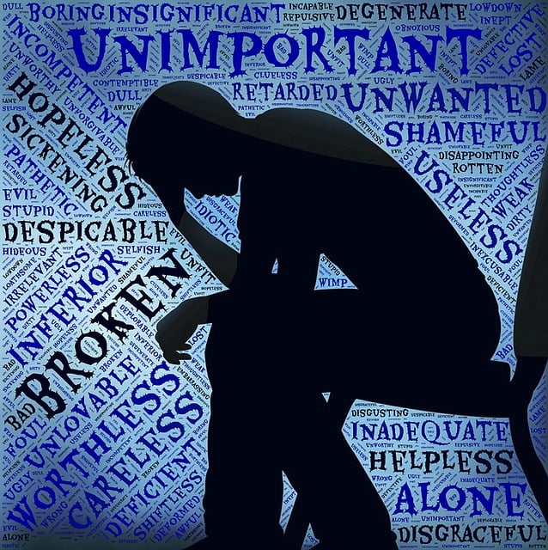
What is Depression?
More than just feeling sad
A mood disorder causing persistent feelings of sadness and loss of interest
Can affect how you think, feel, and handle daily activities

Slide 4
Common Symptoms Anxiety:
Restlessness or nervousness
Racing thoughts
Sleep problems
Panic attacks
Depression:
Persistent sadness
Feelings of worthlessness

Slide 5

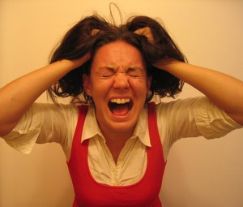
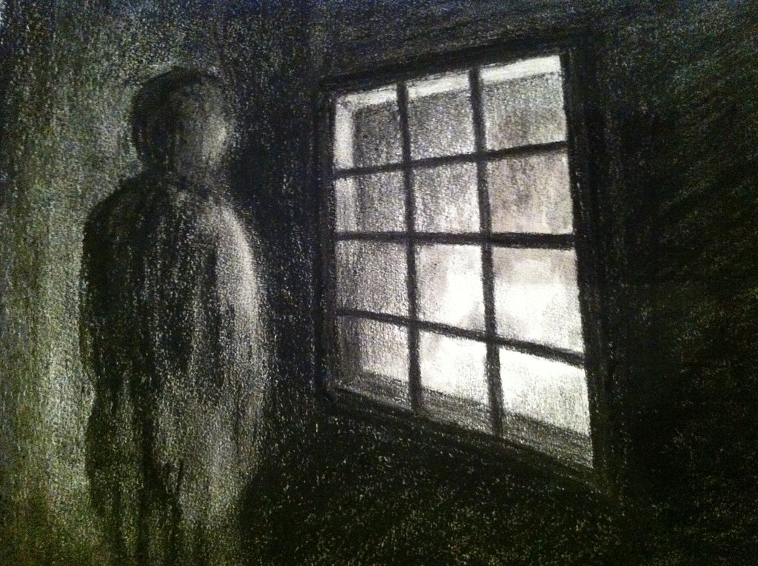
Causes & Risk Factors
Biological: Genetics, brain chemistry
Psychological: Trauma, stress
Environmental: Life events, isolation
Lifestyle: Poor sleep, lack of exercise

Slide 6
Coping Strategies
Regular physical activity
Meditation
Maintaining a routine
Connecting with supportive people
Limiting alcohol and caffeine

Slide 7
Final Thought
Take care of your mental health every day

Slide 8


